Slide 1
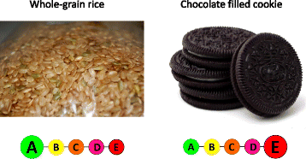
Data set
The data for the study comes from Kaggle’s Open Food Facts database, an open database of food products around the world.
It contains a nutrition grade for every entry, graded from A to E decreasing with an associated color code:
Image from:
nutritionj.biomedcentral.com/articles/10.1186/s12937-0)

Slide 2
Data set
10 categories:
Beverages
Cereals and potatoes
Fruits and Vegetables
Composite Foods
Fats and sauces
Fish Meat Eggs
Milk and Dairy products
Salty Snacks
Sugary Snacks
Sub categories: ex Composite foods :
One dish meal,
Pizza and quiche
Sandwich
200 attributes - retained 14
additive number /100 grams
Fiber /100 grams
protein /100 grams
carbohydrates /100 grams
sugar /100 grams
Fat /100 grams
saturated fat /100 grams
salt /100 grams
sodium content /100 grams
energy /100 grams
pnns_groups_1 (category)
pnns_groups_2 (subcategory)
country of origin
nutrition grade (nutrition_grade_fr)

Slide 3
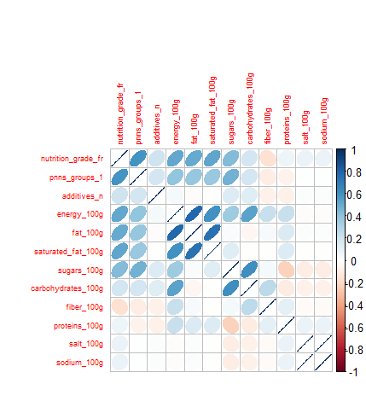
Data set
I

Slide 4
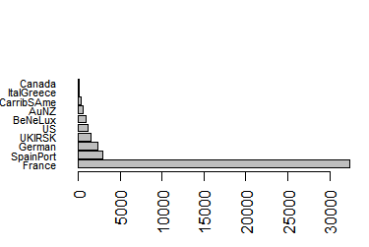
Data set
France:>32000 entries out of 45000
I

Slide 5
Project objectives
Problem 1: predict food grade based on nutrition info .
Problem 2: predict food category based on the nutrition info and nutrition grade
Problem 3: Give a visual of
Type of foods produced/consumed in different geographic regions.
Nutrition grade of foods produced/consumed in different geographic regions

Slide 6
Methodology – analysis
Formulas:
nutrition score: ~nutritional info
main category: ~nutritional info +food score
logistic regression (library - nnet): multinom(formula, data)
Split data in training and test. Fit on training data: multinom(formula, data=train)
Predict test results : predict(model, type="class", newdata=test)
Test performance verify results: confusion matrix and statistics

Slide 7
Model
Coefficients: (reference grade A)
 | Additives number 100 gr | Fiber 100 gr
B | 0.1316794 | -0.3438830
C | 0.1397195 | -0.3919027
D | 0.1816822 | -0.5993707
E | 0.2293385 | -0.7104296

Slide 8
Results
Predict score:
Accuracy = (TP+TN)/(TP+FP+TN+FN) 62.15%
Accuracy allowing 1 grade difference error: 92% !
Prediction Reference | a | b | c | d | e
a | 1431 | 354 | 188 | 35 | 30
b | 262 | 673 | 245 | 84 | 178
c | 135 | 378 | 1387 | 440 | 55
d | 4 | 49 | 434 | 1780 | 602
e | 0 | 1 | 19 | 322 | 833

Slide 9
Results
Predict category:
Accuracy: 74.97 %
Prediction Reference | Beverages | Cereals and potatoes | Composite foods | Fat and sauces | Fish Meat Eggs | Fruits and vegetables | Milk and dairy products | Salty snacks | Sugary snacks
Beverages | 702 | 2 | 4 | 12 | 0 | 15 | 76 | 0 | 92
Cereals and potatoes | 2 | 842 | 36 | 1 | 2 | 36 | 2 | 27 | 41
Composite foods | 16 | 107 | 673 | 39 | 63 | 90 | 12 | 11 | 44
Fat and sauces | 5 | 4 | 22 | 479 | 8 | 26 | 5 | 5 | 2
Fish Meat Eggs | 9 | 39 | 44 | 10 | 960 | 5 | 169 | 29 | 13
Fruits and vegetables | 47 | 287 | 103 | 28 | 55 | 1018 | 84 | 4 | 7
Milk and dairy products | 74 | 7 | 151 | 88 | 117 | 3 | 1236 | 90 | 31
Salty snacks | 2 | 39 | 9 | 6 | 0 | 1 | 2 | 324 | 21
Sugary snacks | 67 | 96 | 1 | 5 | 141 | 21 | 25 | 28 | 2050

Slide 10
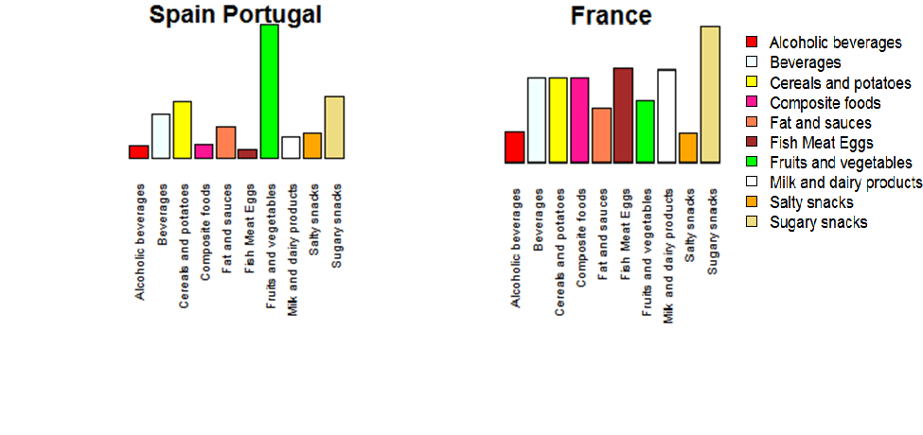
Visuals
Spain is for vegetarians. France is for meat eaters.

Slide 11
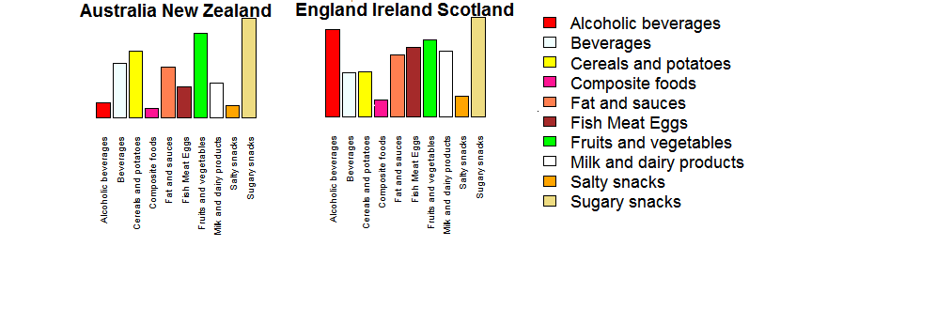
Food Categories in countries

Slide 12
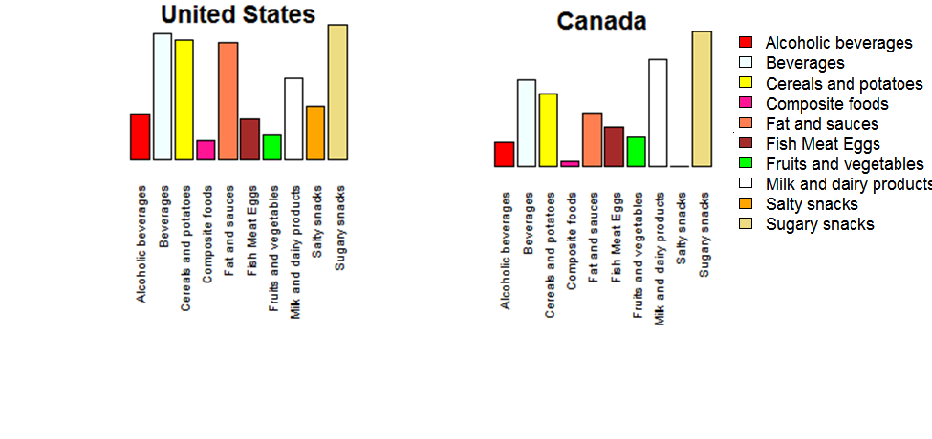
Visuals

Slide 13
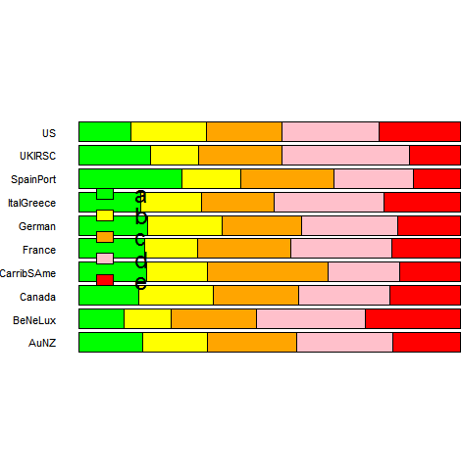
Visuals
Food Scores per countries – Spain leads in Grade A

Slide 14
Conclusion
Based on confusion matrices and overall statistics, food category and nutrition grade can be predicted with good accuracy based on key nutritional ingredients.
Accuracy increases significantly if we are tolerant to errors between adjacent food grades.
Analysis of food categories and geographical regions show that from 43000 entries, 32000 are from France alone. It offers an image of food categories and nutritional scores inside a geographical region
Code used and output files available on Github at: https://github.com/Darianne/fact-foods---ryerson-capstone

